Slide 1
The Battle of the Neighborhoods Hotels in Northeast Brazil
GAEL T. YOTA
06/09/2020
Notes:
We designed this template so that each member of the project team has a set of slides with its own theme. Members, here’s how you add a new slide to just your set:
Mark where you want to add the slide: Select an existing one in the Thumbnails pane, click the New Slide button, then choose a layout. The new slide gets the same theme as the other slides in your set.
Careful! Don’t annoy your fellow presenters by accidentally changing their themes. That can happen if you choose a different theme from the Design tab, which changes all of the slides in the presentation to that look.

Slide 2
Agenda / Topics
Project Description
Project Methodology
Key Findings/Results
Conclusion

Slide 3
Project Description
Objective
Results
Obtain touristic data for two major touristic cities in Brazil
Clean the data
Cluster the data
Determine the best neighborhoods in these cities
Cluster the neighborhoods based on value of lodging, and good location

Slide 4
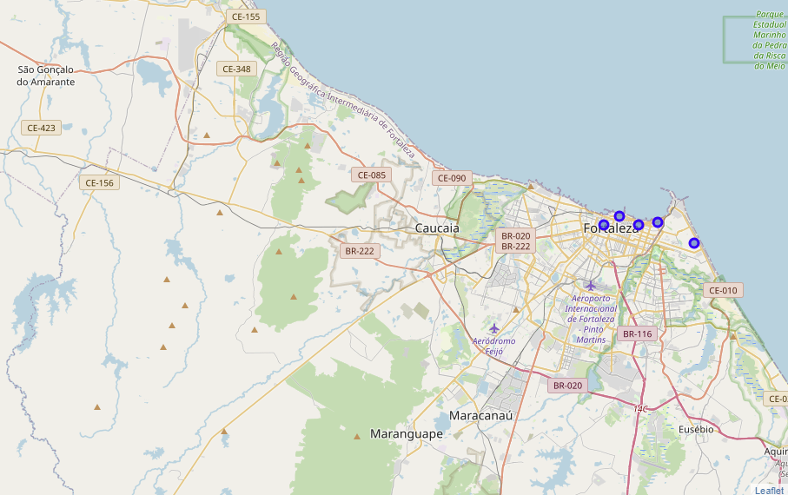

Slide 5
Procedure/Methodology
Procedure
Obtain Data from location candidate
Use Foursquare API to get info on Venues
Select relevant features for our analysis
K-Means algorithm for grouping by Clusters
Visualization of the Clusters

Slide 6
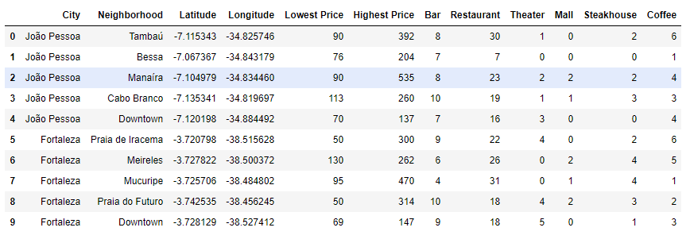
Data from location candidate

Slide 7
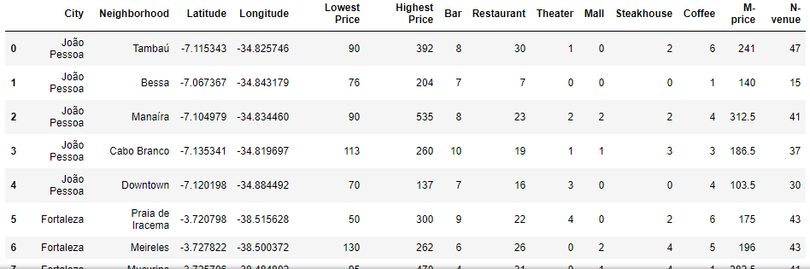
Grouped relevant features for our analysis

Slide 8
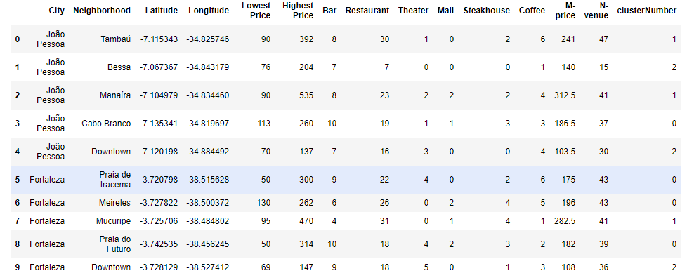
K-Means algorithm for grouping by Clusters

Slide 9
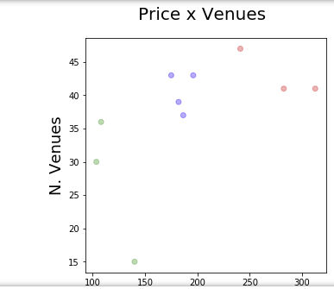
Visualization of the Clusters

Slide 10
Key findings/results
Determinations of best neighborhood groups with bars, restaurants, theaters, malls, steakhouse, coffee shops with the best prices.

